Slide 1

Team Presentation

Slide 2
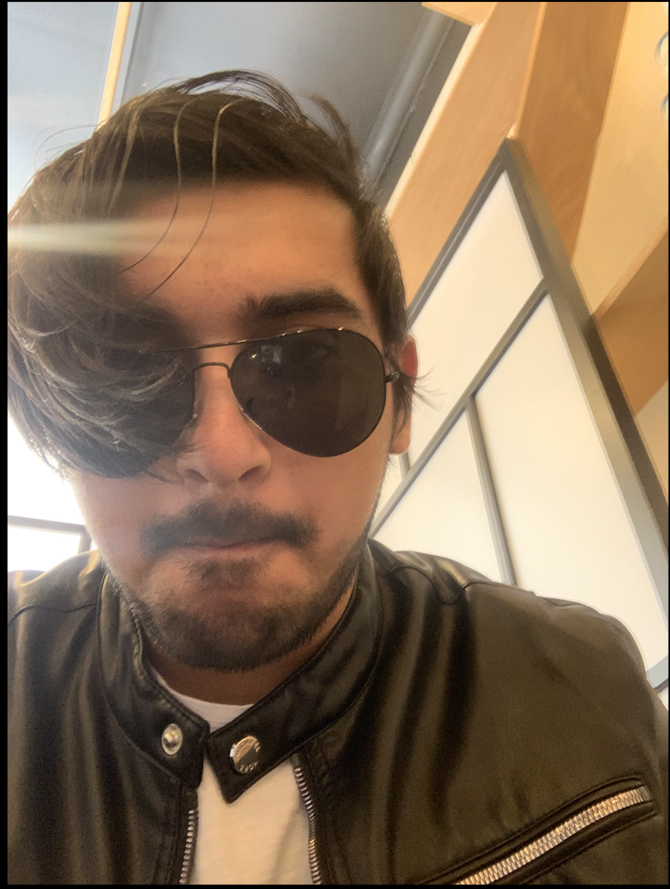
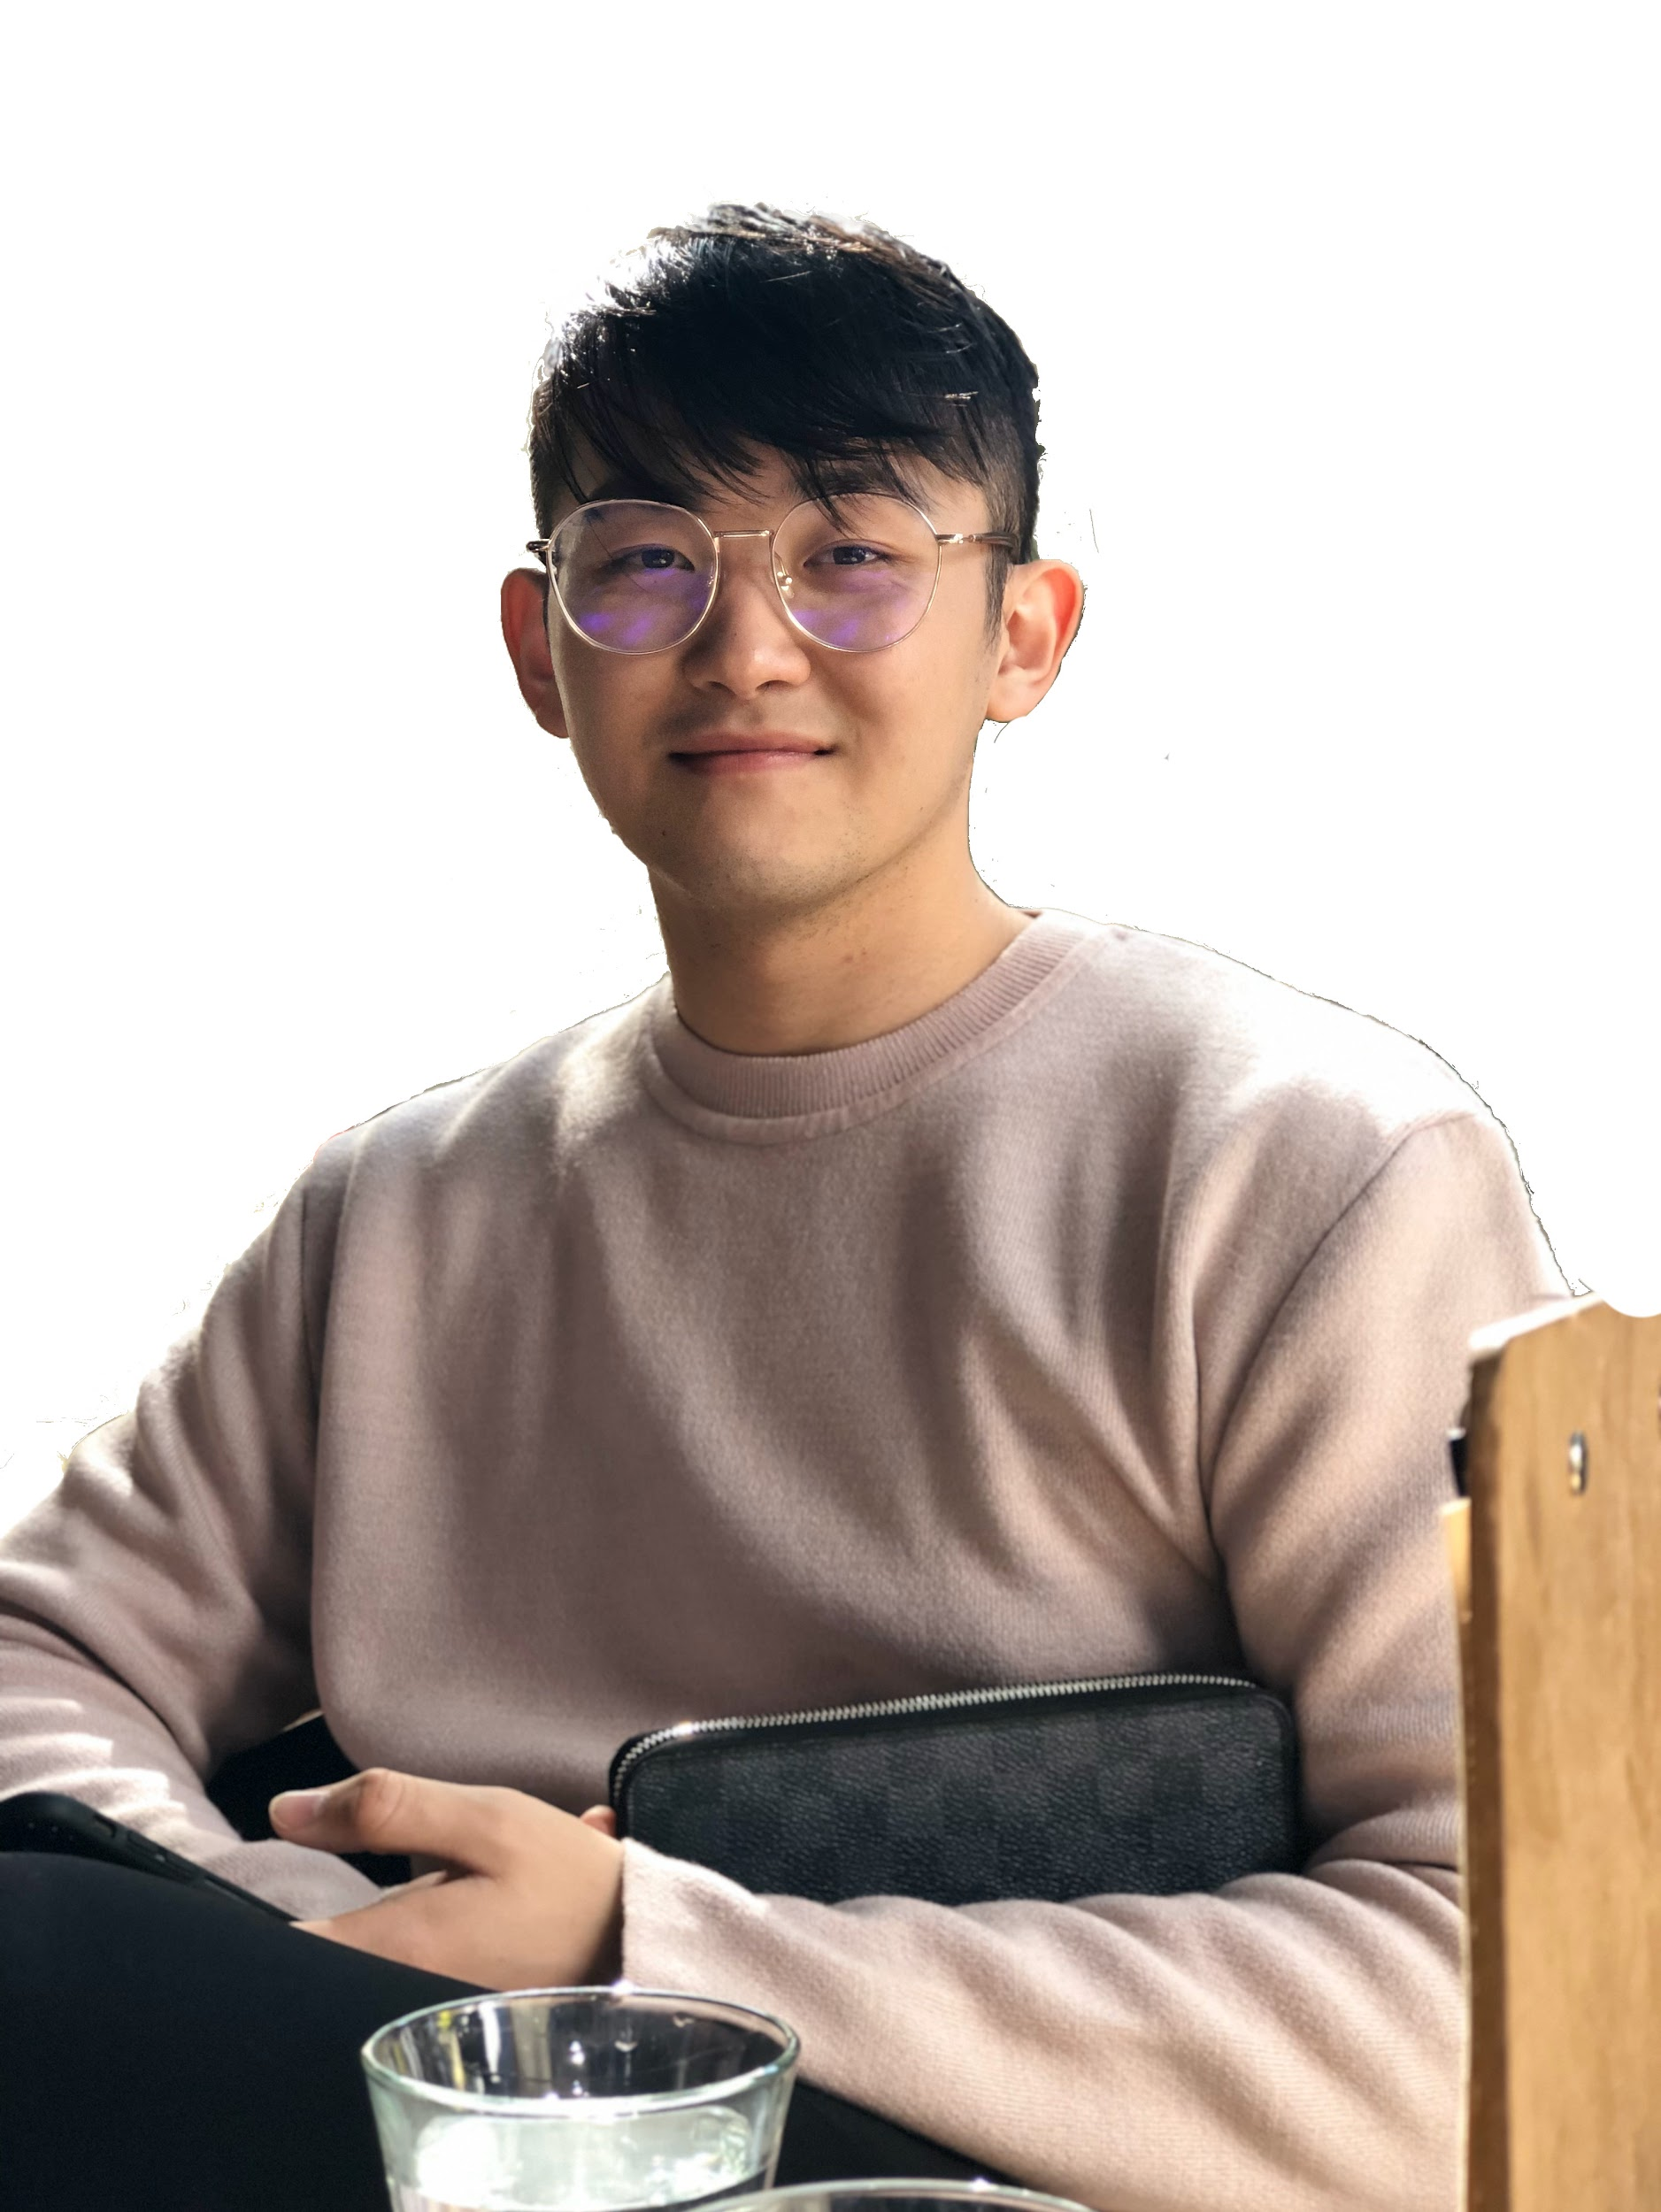
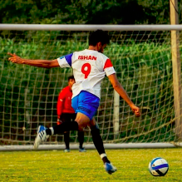
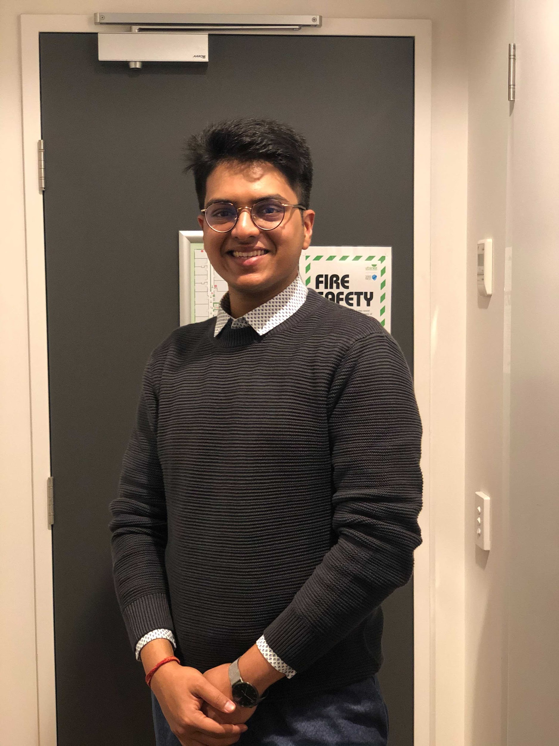

Team members
Abhilash Misra
Front-End Developer
“This semester was long….”
Qunzhi Wang
Backend Developer
“Hopefully this is my last semester…”
Ishan Goyal
Backend / DevOps
“Wear your mask”
Lakshya Mittal
Designer/Developer
“I’m working on it”
Muchun Xu
Front-End Developer
“3 days and no satisfting profile photo”

Slide 3
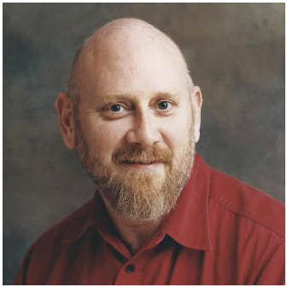
Special Mention
Doc
Tutor
“What did you do last week?”

Slide 4

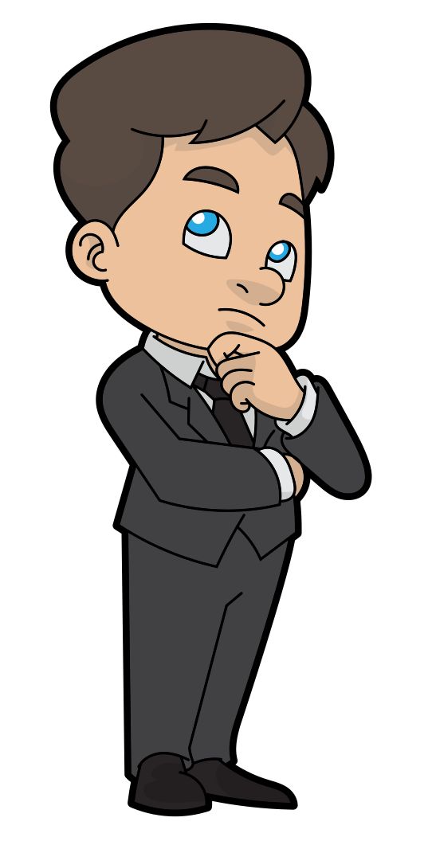
Client Requirements
INTERACTIVE VIEW
PROFILE QR CODE
CUSTOMISABLE
CONTENT
SOCIAL MEDIA INTEGRATION

Slide 5






Technologies Used - MERN stack

Slide 6






Collaboration tools

Slide 7
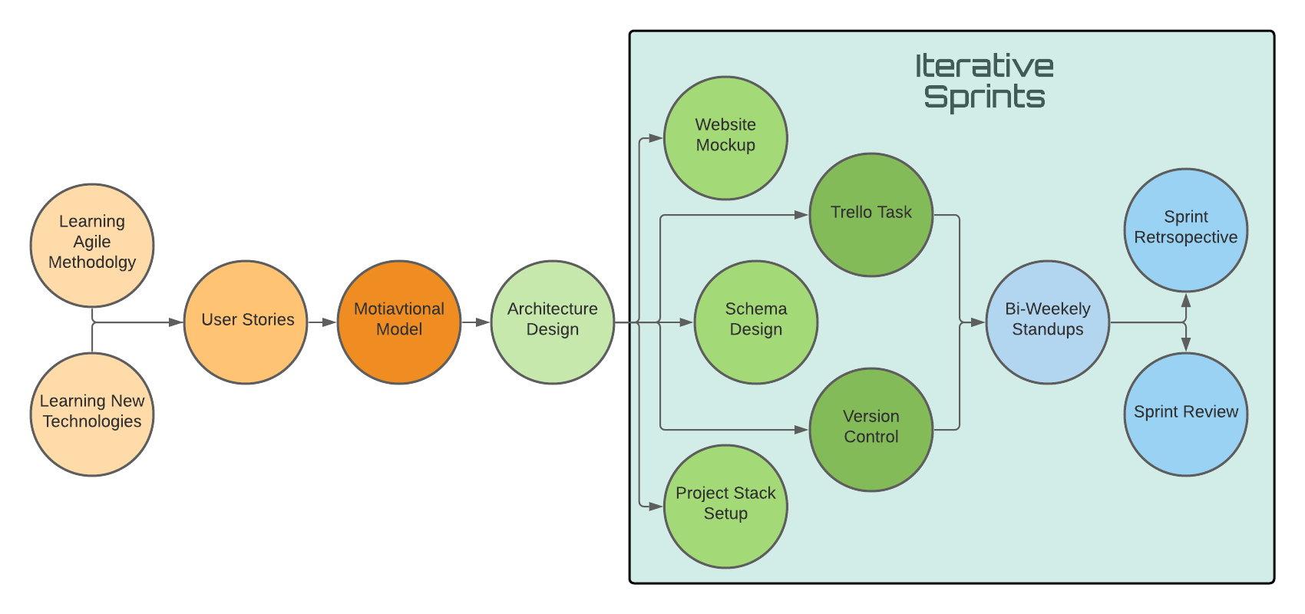
Development Trail

Slide 8
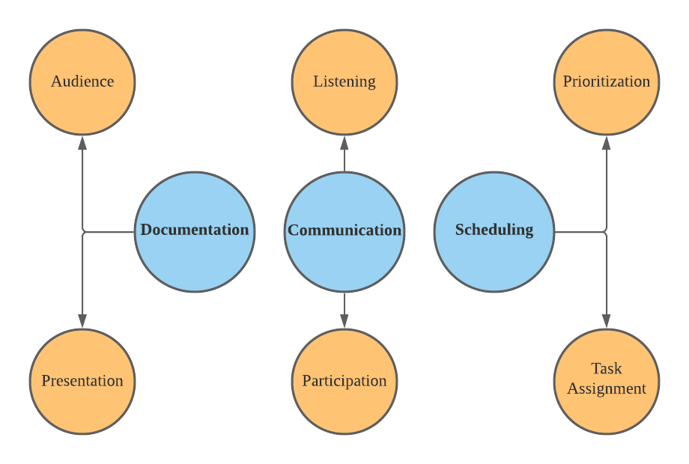
Key Learnings

Slide 9

Key Challenges

Slide 10
Product demonstration

